Slide 1
”DIKSHA” Sundaram Fin.Tech 2025
Journey Presentation –week 3
Anil Rasa
Date : 01-MAR-2025

Slide 2

Topics Covered in Third Week !

Slide 3
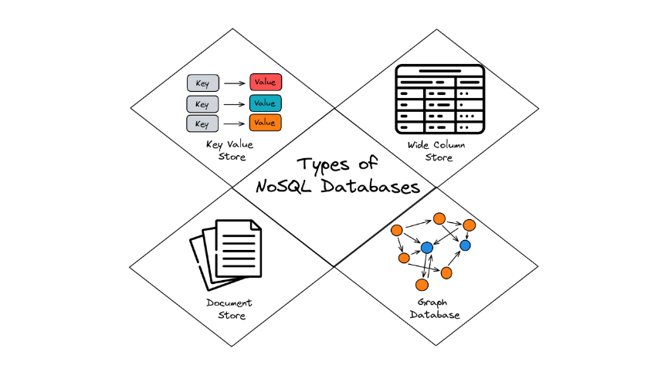
Learning 1 | My takeaways
→MongoDB
→No SQL Types
→Features Of MongoDB
→MongoDB Types
→Embedded Documents

Slide 4
MongoDB: MongoDB is a free, open-source database that stores data in flexible documents instead of tables.
-MongoDB is used for high-volume data storage.
Types of NoSQL Database:
1)Document-based databases 2)Column-oriented databases 3)Graph-based databases.
→Document-based databases are a type of NoSQL database that store data in flexible, schema-less documents.
a database management system (DBMS) that stores data on disk in columns instead of rows.
Graph-based databases are platforms that store data using nodes, edges, and properties.
Features of MongoDB:
Document-Oriented Storage: stores data in JSON format
Schema Flexibility:Unlike relational databases, MongoDB does not require a fixed schema.
Scalability:Supports horizontal scaling using sharding,distributing data across multiple servers.
High Performance:Indexing: Supports various types of indexes to improve query speed.
COMMANDS IN MONGO DB:
Show dbs - To show all databases.
Use Database_name: to switch desired database.
show collections: This command is used to list all tables in database.
db.dropDatabase(): This coomand drops a database
db.collectioname.drop(): Removes a collection
→db.adminCommand({ getCmdLineOpts: 1 }): show the path where mongodb stores the database and collections
→mongod --dbpath "D:\mongodb_data" : This can be used when you want to start mongodb from your custom path
Embedded Documents: A document contains another document then it is said to be embedded document.
db.myEmp.insertOne({name: "Mahesh", dept: "HR", Qualification: "MCA", Address:{city:"Bangalore", state:"Kar", pincode:560001}})
Q

Slide 5
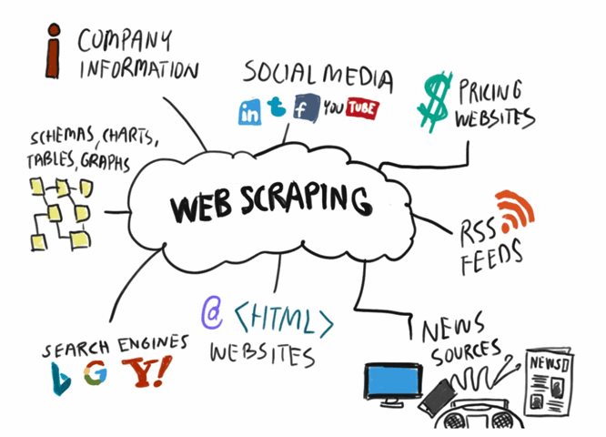
Learning 2| My Takeaways
→Types of data
→ Data Life cycle
→web scrapping
→OLAP VS OLTP
→ETL

Slide 6
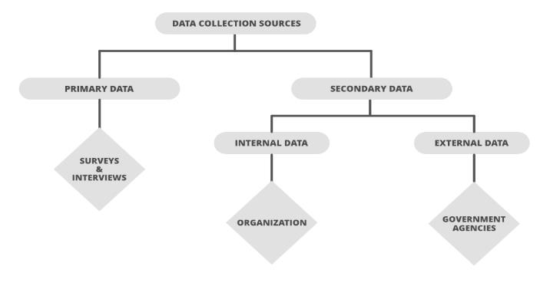
Data:Data is information that is collected through observations, research, or analysis.
Types of data:→1.Structured 2.Unstructured 3.Semi-structured
A source of data is the origin of information that is used for research,
analysis, or decision-making. Data can come from internal or
external sources
Data cleansing: The process of fixing or removing incorrect,
incomplete, or irrelevant data from a dataset.
Web scraping: It is the process of using bots to automatically extract data from websites. It's also known
as web harvesting or web data extraction.
OLAP VS OLTP: Online analytical processing (OLAP) and online transaction processing (OLTP) are two different data processing systems. OLAP is used for analyzing data, while OLTP is used for processing transactions.
ETL: ETL stands for Extract,Transform, and Load. It's a data integration process that combines data from multiple sources into a single data warehouse or data lake. ETL is often used to build a data warehouse.
The 5 V's of big data are volume, velocity, variety, veracity, and value. These characteristics help businesses understand and manage large amounts of data.

Slide 7
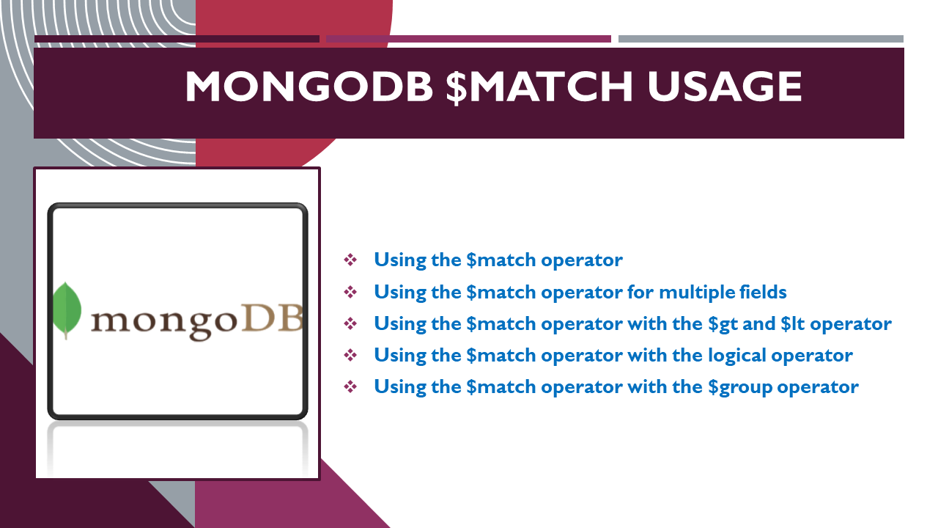
Learning 3| My takeaways
→Operators in MongoDB
→Projections
→Aggregations
→HTML
→Logical and Physical Tags

Slide 8
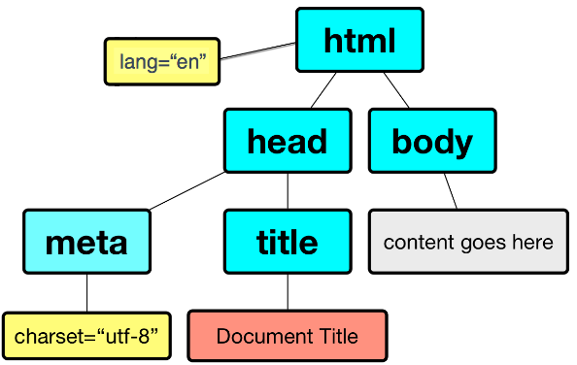
Comparison Operators: 1) $eq 2) $ne3) $gt 4) $gte 5) $lt 6) $lte 7) $in 8)$nin
Element Operators:1)$exists 2) $type 3) $size
Logical Operators: 1) $and 2) $or 3) $nor 4) $not
Projections: is another name for selecting certian fields i.e showing or hidding the desired fields
Aggregation:Helps in performing few operations like: min,max,sum etc...
Valid Aggregation Stages
$count,$group,$limit,$lookup,$match,$merge,$sort,$project,$unwind,$unset
Pipeline: Array of stages (or) A pipe line is also called as a sequence of operations.
WEB UI PROGRAMMING:
HTML:standard markup language for documents designed to be displayed in a web browser.
Basic Tags: html,head,tittle,body,h1,h2,h3,h4,h5,h6,p.
Tables:allow web developers to arrange data into rows and columns.
Syntax: <table>
<head> <tittle> ………</tittle> </head>
<body>
</body>
</table>
Lists: An HTML List allows you to organize data on web pages into an ordered or unordered format to make the information easier to read and visually appealing.
Unordered Lists B) Ordered Lists C) Description Lists
Form :
An HTML form is a section of a web page that allows users to enter data.
text,tel,email,radio,checkbox,date,month,week,number,url etc…

Slide 9
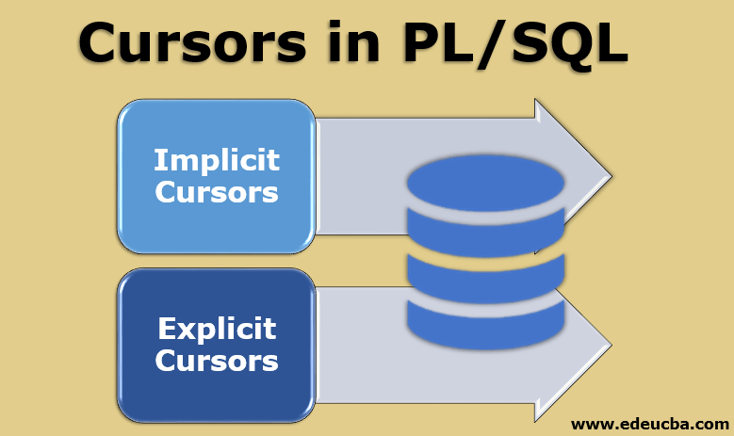
Learning 4 | takeaways
→Types of Cursors
→Exceptions
→Procedures

Slide 10
CURSOR: Cursor is a pointer to private area allocated by all the oracle server .it is used to handle the result set of a select statement.
Types of cursor:
1)Implicit → Create and managed internally by oracle server process SQL statements.
2)Explicit → Declared explicit by programmer.
Types of cursor attributes: 1)%FOUND 2)%NOT FOUND 3)%IS OPEN 4)%ROW COUNT
EXCEPTIONS: Exception is a PL/SQL error that is raised during program execution.
1)Implicit: implicit exception is done by oracle server.
2)Explicit: Explicit exception is written by programmer.
→Predefined exceptions are 1)Zero divide 2)No data found 3)To many rows 4)Invalid cursor
Procedures:
A SQL procedure is a pre-written, reusable code block designed to perform a specific task or set of tasks.
Anonymous: anonymous block is complied every time.Data not stored in the database.Cannaot be involved by other applications ,Do not return values.
Sub programms:
Named pl/sql block complied only once,stored in database ,named can be involked by other applications ,if functions must return values can take parameter.

Slide 11
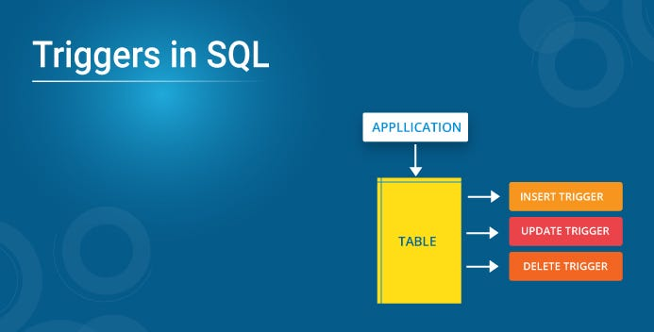
Learning 5 | Takeaways
→Functions
→Triggers

Slide 12
Functions:In PL/SQL, a function is a set of statements that performs a task by accepting inputs, performing an action, and returning a result.
Syntax: create or replace function function_name
Ex:-CREATE OR REPLACE FUNCTION CALCULATE_FACTORIAL(n IN NUMBER) RETURN NUMBER IS
Fact NUMBER :=1;
BEGIN
FOR i IN 1..n LOOP
fact:=fact*i;
END LOOP;
RETURN FACT;
END;
Triggers: PL/SQL triggers are block structures and predefined programs invoked automatically when some event occurs.Types of triggers: 1)Row level trigger 2)Statement trigger
Syntax for create trigger: create trigger trigger_name(After|Before) (Insert|Update|Delete) ON
begin
--variable name
--trigger code
end;
NEW is a pseudo-record name that refers to the new table row for insert and update operations in row-level triggers. Its usage is :NEW.
OLD is a pseudo-record name that refers to the old table row for update and delete operations in row-level triggers. Its usage is :OLD.

Slide 13
Thank You

